Slide 1
Python list ,tuples

Slide 2
Accessing list elements and traversal
List indices work the same way as string indices.
Thus you can use the subscript operator to access the list elements.

Slide 3
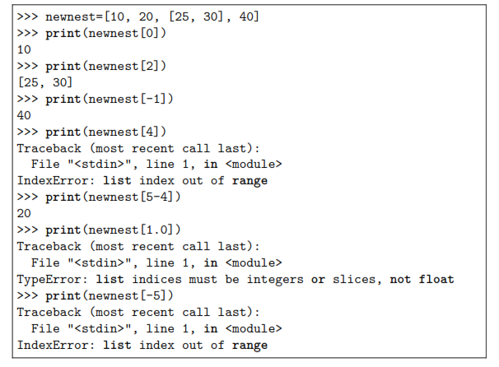

Slide 4
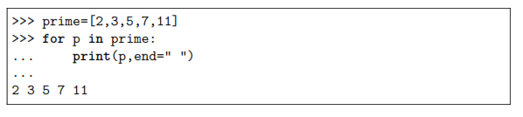
You could also use an expression as an index in the subscript operator, as newnest[5-4] in the example above.
The interpreter will evaluate the expression to determine the index.
Printing the list
by specifying its name in the print method displays the list elements enclosed in a pair of brackets.
To display the entire list without the brackets themselves, you should traverse the list printing the elements one by one.

Slide 5
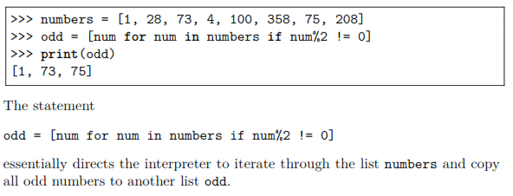
list comprehension
Creating a new list from an existing list is called list comprehension.
Assume you have a list of numbers from which you want to create another list consisting only of odd numbers in the original list.
This can be done by using a for loop to traverse the original list and copying the odd numbers to a second list.
But with list comprehension, life is far more easy! See below:

Slide 6
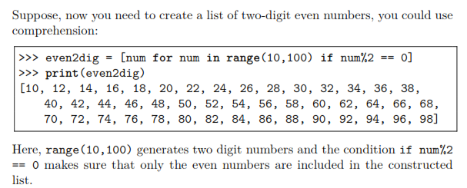

Slide 7
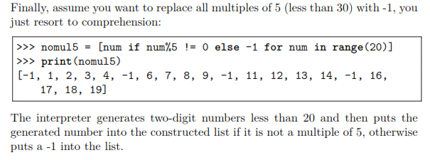

Slide 8
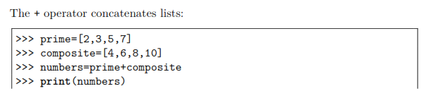
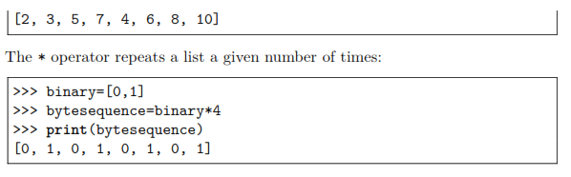
List operations

Slide 9
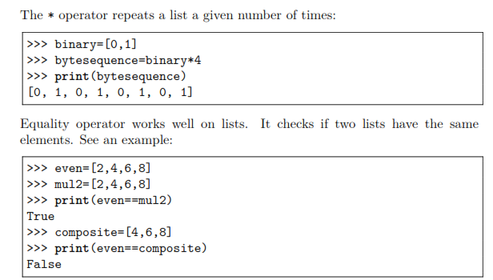

Slide 10
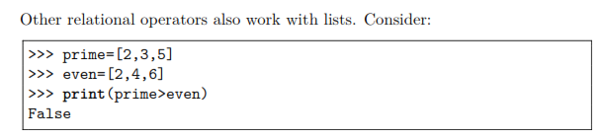
Python starts by comparing the first element from each list.
If they are equal,it goes on to the next element, and so on, until it finds the first pair of elements that are different and determines the relation between them.
In the above example, prime[0] = = even[0]. Next, prime[1] and even[1] are compared.
Thus the resulting relation is ‘<’ and prime > even is thus False.

Slide 11
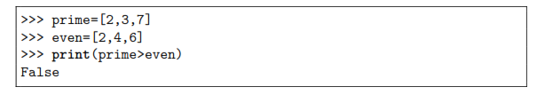
Note that once the result is determined, the subsequent elements are skipped.

Slide 12
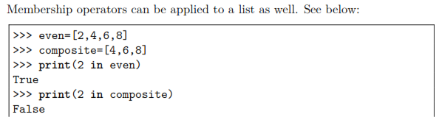


Slide 13
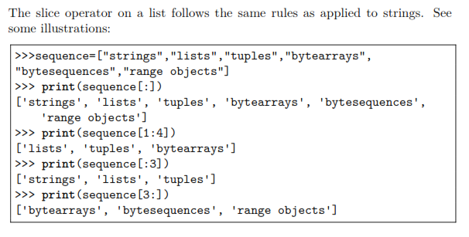
List slices

Slide 14
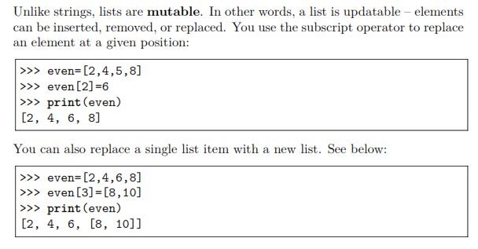
List mutations

Slide 15
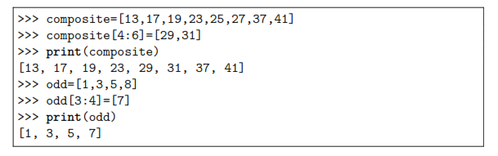
Slice operator and mutations
The slice operator is a nice tool to mutate lists in terms of replacing, inserting,or removing list elements.
Replacing elements
You can use the slice operator to replace a single element or multiple elements in a list.

Slide 16
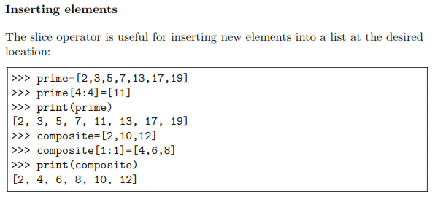

Slide 17
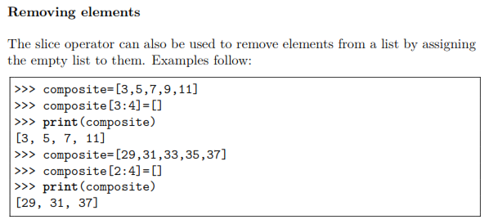

Slide 18
Using del keyword for deletion
Assigning a list element to an empty list for deletion is cumbersome.
As an alternative,Python provides the del keyword exclusively for deletion.

Slide 19
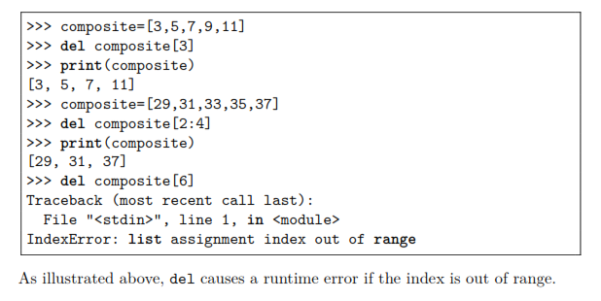

Slide 20
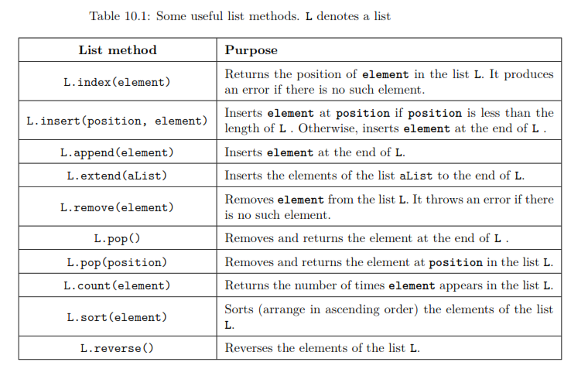
List methods :The list type includes several methods for inserting and removing elements. s. L denotes a list

Slide 21
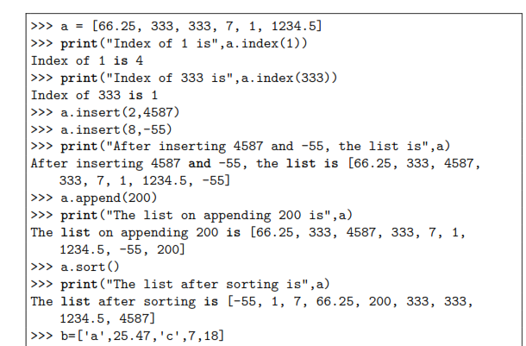

Slide 22
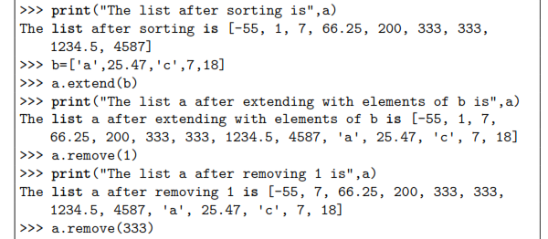

Slide 23
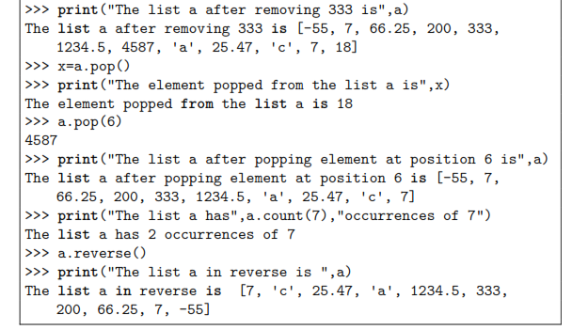

Slide 24
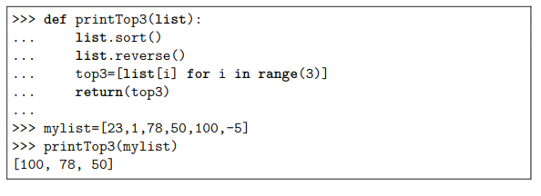
Lists and functions
A function can be made to return multiple values using lists.
This is done by defining the function to return a list of values instead of a single value as in the
normal case. The following code illustrates this:

Slide 25
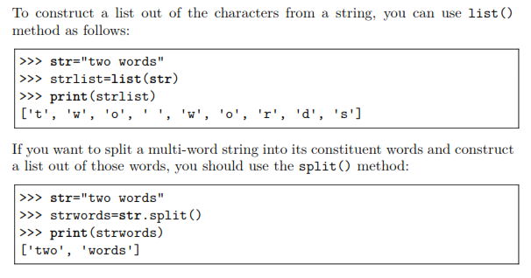
Strings and lists

Slide 26
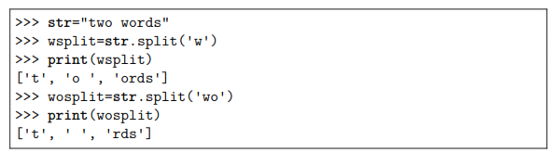
the white space where you split the string is known as the delimiter.
If you want to specify a different delimiter, you can pass that character (or even a string) as an argument to the split() method.

Slide 27
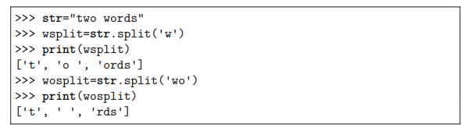

Slide 28
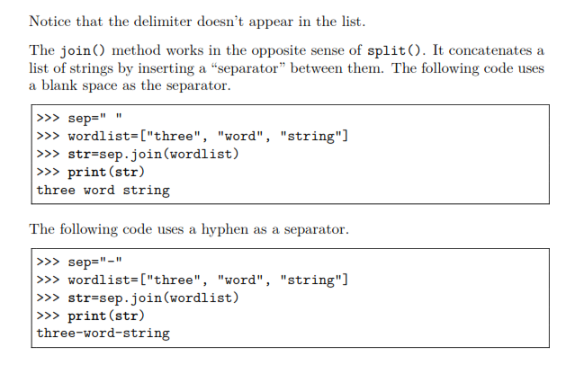

Slide 29
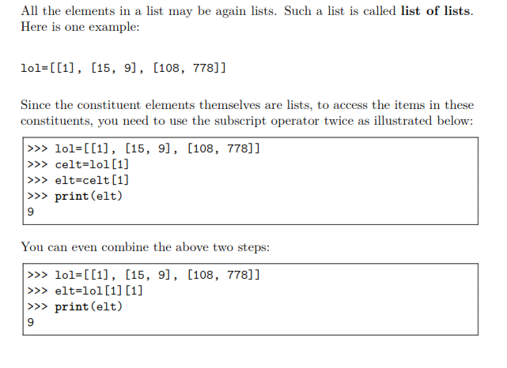
List of lists

Slide 30
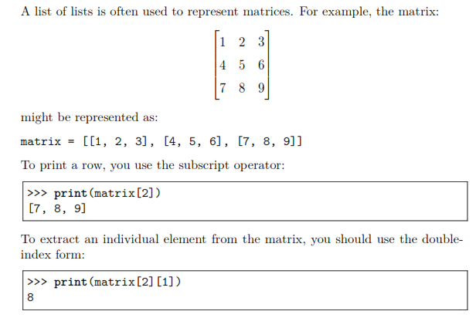

Slide 31
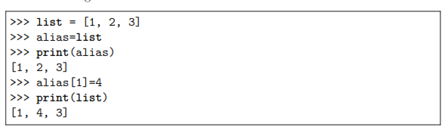
List aliasing and cloning
If you assign a list variable to another, both variables refer to the same list.
Because the same list has two different names now, we say that the list is
aliased. Changes made with one list affect the other.

Slide 32
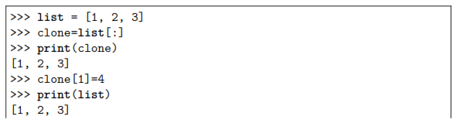
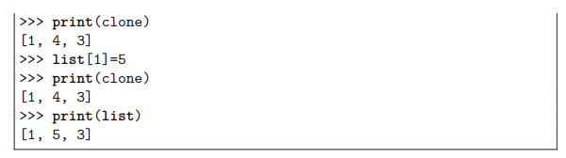

If you want to modify a list and also keep a copy of the original, you need to
use a technique called cloning.
The easiest way to clone a list is to use the slice operator.

Slide 33
Equality of lists
A list and its alias refer to the same list.
On the other hand, a list and its clone refer to two different lists although both have the same elements.
The equality between a list and its alias is object identity and the equality between a list
and its clone is known as structural equivalence.
The is operator can be used to test for object identity.
It returns True if the two operands refer to the same list, and it returns False if the operands refer to distinct lists (even if they are structurally equivalent).
T

Slide 34
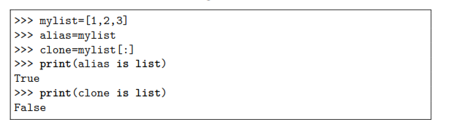
Equality of lists
The following code illustrates this:
Consider the following code:

Slide 35

tuples
A tuple is a sequence of values that resembles a list, except that a tuple is
immutable.
You create a tuple by enclosing its elements in parentheses instead
of square brackets.
(Strictly speaking, the enclosing parentheses are optional, but are included to improve readability.) The elements are to be separated by commas. Following are some examples:

Slide 36
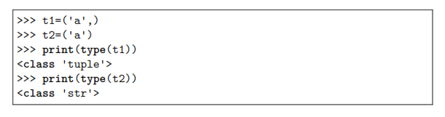
To create a tuple with a single element, we have to include a comma at the end, even though there is only one value.
Without the comma, Python treats the element as a string in parentheses.

Slide 37
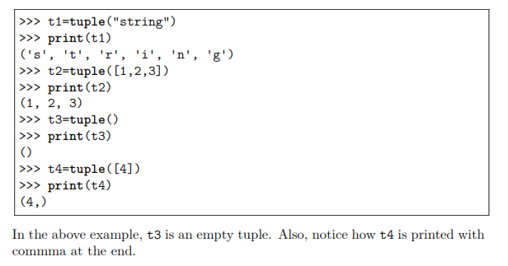
Tuple creation
a tuple can be created by enclosing its elements in parentheses.
Another way to create a tuple is to use the tuple() function.

Slide 38
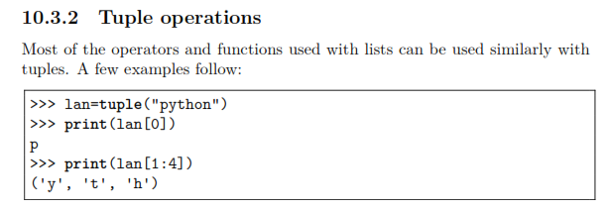

Slide 39
